Slide 1
Module 2: Lesson 2 Skills Assessments & Career Exploration Tools
U.S. Department of Labor—Employment & Training Administration| Missouri Economic Research and Information Center| Missouri Department of Economic Development
This project has been funded, either wholly or in part, with Federal funds from the Department of Labor, Employment & Training Administration under Task Order Number DOLJ061A20373; the mention of trade names, commercial products, or organizations does not imply endorsement of same by the U.S. Government.
Notes:
Hi everyone, thank you for joining us again. Today will be going over the second lesson in Module 2: Using Skill Assessments & Career Pathway Planning. Before you complete this module lesson, you should have already completed the LMI Fundamentals module and Lesson 1 of this module. If not, please do so now before continuing.

Slide 2
Today’s Lesson
Module 1: Labor Market Information Fundamentals
Module 2: Using Skill Assessments & Career Pathway Planning
Lesson 1: Creating a Career Pathway
Lesson 2: Skills Assessments and Career Exploration Tools
Module 3: Using Economic & Workforce Data to Drive Reemployment Strategy
Module 4: Guiding Businesses/Partners to Use Workforce System & LMI Resources to Support Human Resource Functions
Notes:
Today we will be covering Lesson 2: Skill Assessments and Career Exploration Tools. We will be going over the final two steps of the Four Steps to Assist Job Seekers we began in lesson 1 using some LMI tools that allow for more detailed occupational analysis.

Slide 3
What’s in it for me?
After participating in this module, you will be able to:
Understanding Skills Assessments
Identify Use of O*Net
Navigate O*Net Online
Identify Use of Missouri Education and Career Tool
Notes:
After participating in this module, you will be able to:
Better understand Skills Assessments tools,
Identify Use of O*Net
Navigate O*Net Online, and;
Identify the Use of the Missouri Education and Career Tool

Slide 4
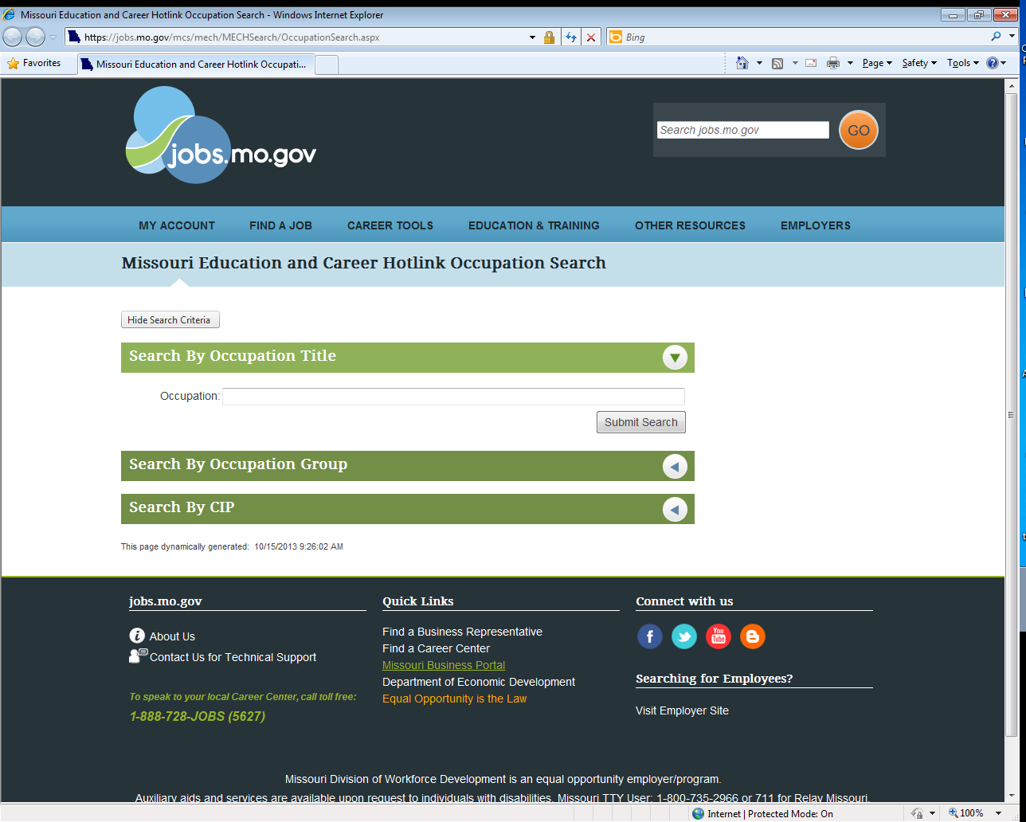
Career Exploration Tools
Communication in a Common Language
Employers
Job Seekers
Workforce Developers
Integrated Systems
Missiouriconnections.org
Missouri Education and Career Tool
CareerOneStop
Notes:
A career exploration tool is somewhat of a one-stop shop of LMI for job seekers, businesses, and workforce developers when looking at occupations. They can include employment, wage, and career planning LMI all in one.
They are often capable of being integrated into many other employment tools. O*Net Online’s occupational information in embedded in the MissouriConnections.org site and the Missouri Education and Career Tool.

Slide 5
Case Study
Notes:
Now let’s get back to our four step aid to assisting job seekers that we began in lesson 1. When we finished lesson 1, we had covered steps 1 and 2. Now we’ll continue this case study of Robert, our production supervisor, through steps 3 and 4.

Slide 6
Case Study
Dislocated Worker
In Module 2, Lesson 1, we met Robert Smith. A recently dislocated production supervisor from a beverage manufacturing company. We discovered that the outlook for his occupation and his industry were decreasing and he now needs to understand what he can do to find re-employment.
His options may be to simply apply for new vacancies for his occupation within other industries or looking into a new field that would match his transferable skills………. Let’s use our career exploration tools to see if we can help Robert some more.
Notes:
In Module 2, Lesson 1, we met Robert Smith. A recently dislocated production supervisor from a beverage manufacturing company. We discovered that the outlook for his occupation and his industry were decreasing and he now needs to understand what he can do to find re-employment.
His options may be to simply apply for new vacancies for his occupation within other industries or looking into a new field that would match his transferable skills………. Let’s use our career exploration tools to see if we can help Robert some more.

Slide 7
The Four-Step Job Seeker Process
Identify your affected industry & job seeker
Study industry patterns
Determine your job seekers transferable skill set
Narrow down the occupations within the industry that have similar skills for job seekers
Notes:
Here are the four steps we went through last lesson. We looked into the beverage manufacturing industry and talked with Robert to see what his immediate prospects for re-employment in the field were. We also took a more detailed look at what his occupation looks like in his previous industry and other industries he may be considering.
Now we will attempt to determine Robert’s transferrable skill set and narrow down the list of occupations that will meet his criteria. Let’s take a quick review of what we found out last time.

Slide 8
Beverage Manufacturing Management
What We’ve Learned
What’s Next
LEHD – Statewide the industry has small employment and recent job loss
BLS – The beverage manufacturing industry has a 10-year nationally projected employment loss of 0.1% and occupation’s loss of 1.2%
Occupation Projections –In the Central Region First-line production supervisors have a 10 year projected employment increase of 2.56%
Step 3: Determine your job seeker’s transferable skill sets
Step 4: Narrow down the occupations within the industry with similar skills
Notes:
The Beverage manufacturing industry was trending at a decrease and when we looked at the industry projections, it seemed that that would be continuing over the next few years. His occupation within the industry was also not looking too good for Robert. Overall though, his occupation wasn’t too bad off in other industries, giving Robert some hope of keeping his skill set and transferring to a new industry. Now let’s continue……..

Slide 9
Putting the Four-Step Process into Practice……
A Knowledge, Skills, and Abilities Assessment
Educational Assessments: WorkKeys, TABE
Skills Profilers
Interest and Work Values Analysis
O*Net Interest Profiler, Work Profiler Tools
Gap Analysis
Step 3: Determine your job seekers transferable skill set
Notes:
Step 3 is all about getting to know your job seeker. This is what you at the Career Centers do best.
There are many tools available on O*Net online or MissouriConnections.org sites that help with KSA (Knowledge, Skills, and Abilities) assessments. Some may need to take a WorkKeys or TABE (Tests of Adult Basic Education) assessments to see where their skills rank. There is also the interest and work profilers that will be able to answer the other questions of employment: not what am I good at, but what do I actually like doing for work?
Work with your job seeker to complete a skills gap analysis that will help you and them both understand where their strengths lie and what training or education are they going to have to complete to find their dream job. Let’s examine some of the assessment tools out there in Career Centers now.

Slide 10
WorkKeys® Assessments
Notes:
WorkKeys® is a job skills assessment system that helps employers select, hire, train, develop, and retain a high-performance workforce.
Taking WorkKeys tests is an important first step to prepare for education, training, or a career. WorkKeys scores help you compare your skills to the skills real jobs require. The skills can be measured from remedial level to a professional level grade in applied mathematics, locating information, and reading for information.
WorkKeys test questions are based on situations in the everyday work world. Employers across the country are requiring the WorkKeys assessments or recommending the National Career Readiness Certificate. These scores help employers choose the most qualified candidates for their job vacancies.
Occupations are assigned WorkKeys scores so a job seeker will be able to sort through the 800+ SOC code occupations out there to find the ones that make the most sense for them.

Slide 11
O*Net Online Assessment Tools
O*NET Career Exploration Tools
Interest Profiler
Work Importance Locator/Profiler
Ability Profiler
Notes:
For jobseekers who are not quite sure of their transferable skills or what they would like to do in the future, O*Net Online has a set of Career Exploration Tools available on their website. These tools enable individuals to transition from assessing their interests, work values, and abilities to matching their job skills with the requirements of occupations in their local labor market. Two of these profilers are available to print off and complete wherever, allowing the job seeker to complete the profile more accurately since they can take their time and really think through their answers.
There are basically three types of O*NET Career Exploration Tools
Interest Profiler looks into what the job seeker has an interest in when it comes to choosing a career path.
Work Importance Locator/Profiler which is designed to help an individual identify his or her work values and what is personally important to them in a job, and;
The Ability Profiler which is designed to help an individual identify his or her work-related abilities.

Slide 12
O*Net Online Assessment Tools
Notes:
The assessment tools are available to download from the O*Net Online Resource Center and can be stored on any computer or printed off. These tools are also integrated into other career planning tools like MissouriConnections.org.

Slide 13
O*Net’s Career Interest Profiler Results
http://www.mynextmove.org/explore/ip
Notes:
The Career Interest Profiler will help you connect your interests to work you may like to do.

Slide 14
O*Net’s Career Interest Profiler Results
Notes:
Here is an example of a Career Interest Profiler results sheet. You can sort your interest results along with your job zone classification and obtain a concise list of occupations that match both your interests and abilities.

Slide 15
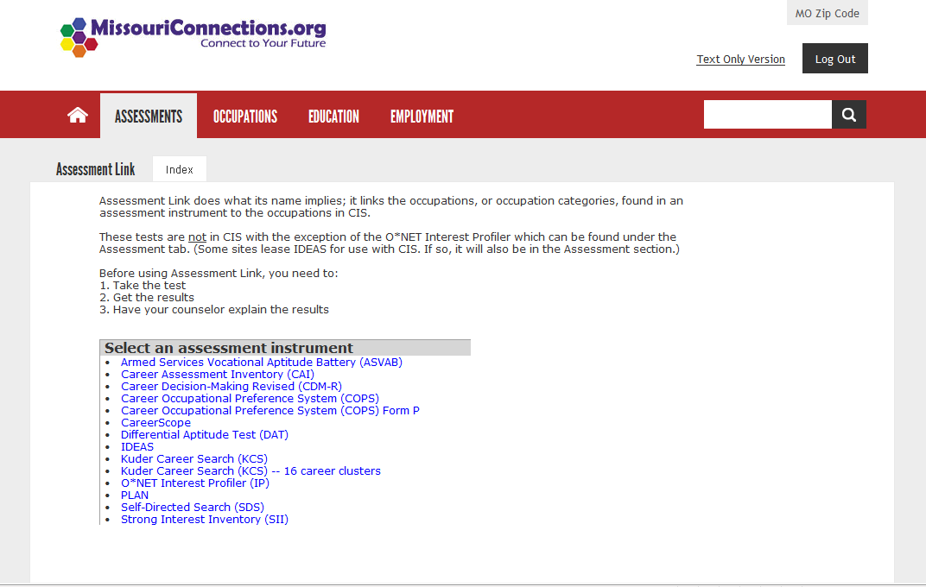
Missouri Connections.org
Notes:
Another good source of career assessment tools is missouriconnections.org. When you log in to the Missouriconnections.org website, we can see the website’s assessment links. There are a variety of assessment tools that a job seeker can take and store to their profile within the site. Some tools that we’re more familiar with on this site are the O*Net Interest Profiler which we just mentioned, and the COPS system of assessments.
Once the job seekers has the results from these assessments and the others that we mentioned they will be able to come to you more self-aware of their interests and abilities, and will have a more narrowed search for what they are looking for in regards to re-employment.

Slide 16
Step 3 Website Links
WorkKeys®:
http://www.act.org/workkeys/
O*Net Career Exploration Tools: http://www.onetcenter.org/tools.html
Missouri Connections: http://www.missouriconnections.org/link.aspx
Notes:
Here are the website links to the LMI Data tools that we walked through in Step 3 of the Four Step Aid to Assisting Job Seekers. Please feel free to pause the webinar here and practice using these data tools yourself. Otherwise make note of them and continue on to finish the lesson.

Slide 17
Putting the Four-Step Process into Practice……
Step 4: Narrow down the occupations within the industry with similar skills
Use O*Net Online or the Missouri Career Exploration Tool to help determine your job seekers next steps…..
Notes:
The last step of the process is the occupation selection for our job seeker and understanding what needs to be done to gain employment. Now we can look through the Career exploration sites to determine what industry and occupation Robert should work in, what skills and training he may need for his occupation to be up-to-date, and Missouri specific information about his opportunities.

Slide 18
Case Study – Data Retrieval
What high-demand occupations require similar skills and education to those of a production supervisor in the beverage manufacturing industry?
O*Net
Create a skills profile
Pair the profile to in demand jobs
Missouri Education and Career Tool
Collect regional projections for prospective occupations
Look at available training or educational opportunities within their area
Notes:
Now in order to best approach this case study, we must answer the following question: What high-demand occupations require similar skills and education to those held by a production supervisor in an beverage manufacturing industry? To answer this we need to create a skills profile for our customer, pair it with similar occupations, see if there is any demand, and whether or not they have the educational requirements to gain employment or where they can go to achieve it.
A little background on what we can expect to see when we are operating in O*Net Online. As we mentioned earlier, the occupations are classified by a SOC code. Each occupation listed has a brief description of the job and its main duties. Each occupation will then have specific lists of the following: Skills, both Basic Skills and Cross-Functional Skills.
Also mentioned are the Work Context, as well as the Experience and Training which are the Five "Job Zones" that distinguish the levels of education and training connected to occupations.

Slide 19
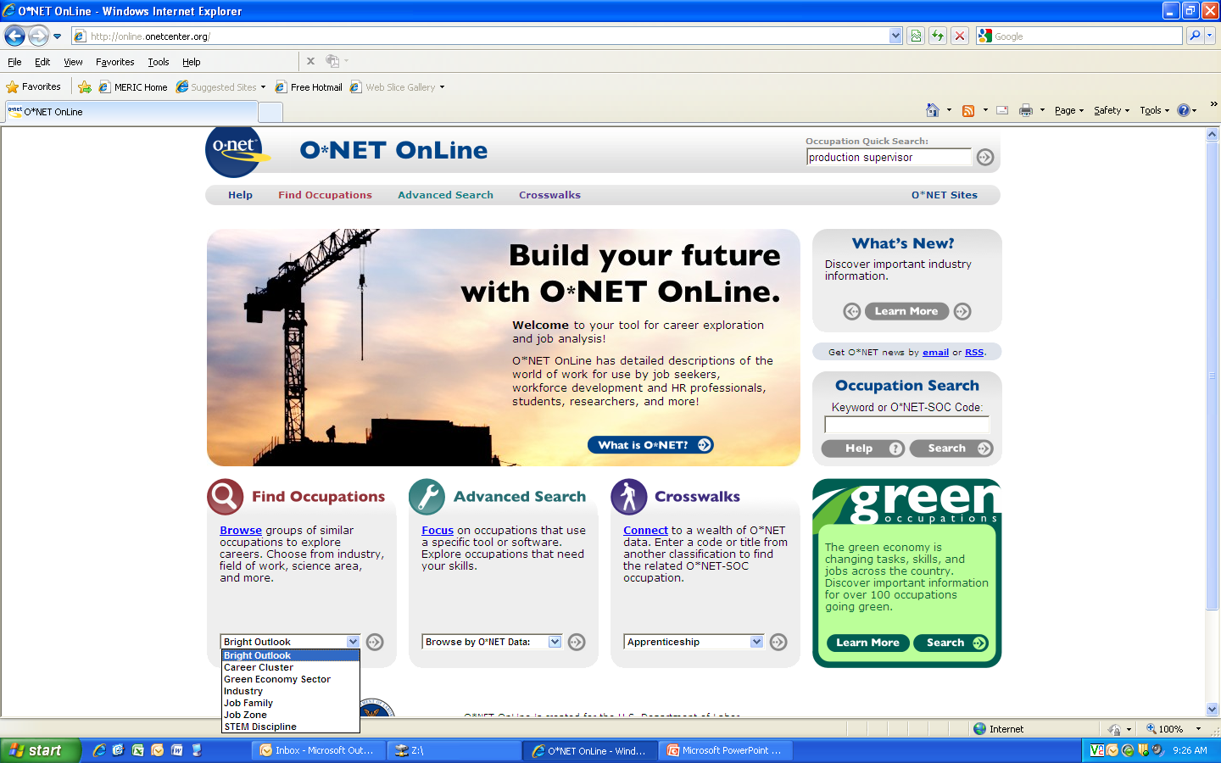
Notes:
This is the user interface for the O*Net Online home page. The easiest way to find occupations is to go through the (*) occupation quick search tool at the top of the page. If you are looking for a grouping of occupations, you may (*) also choose one of the families within the drop down menu located here.
There are other methods of searching within O*Net. We’ll go through a skills search for occupations shortly, but there is also the useful Crosswalk search function. For example, you can choose military occupations within the drop down menu and search by the official military title they had while working there. O*Net will then produce a set of occupations that closely match either the main task of the occupation or the same KSAs. This function in O*Net provides a common language application across other sites.
Now we’ll see what we can find for Robert’s production supervisor position.

Slide 20
Notes:
Here is the list matching the title we entered. The titles are sorted by relevance to the source, and first-line supervisors/managers of production and operating workers’ description best fits what Robert was doing while employed at the company. We’ll click on that hyperlink and see more about the occupation.
Quick note, you will see there is a green leaf located next to our occupation and other occupations in the list as well as a sun icon. The green leaf indicates that an occupation meets “green” efficiency standards set forth by O*Net and would be included in a green production industry. The sun icon is for those occupations that have a better than average outlook for employment.

Slide 21
Notes:
We can see here the basic description of our occupation beneath the title. This is important to read, because while it may seem simple, many times occupations may be misclassified. We want to make sure we are looking at the correct occupation for Robert and all of our job seekers. Since we are trying to answer the question of: What high-demand occupations require similar skills and education to those of a production supervisor in the beverage manufacturing industry? We need to focus on the skills portion of the occupational information.
There are 10 basic and advanced skills that are typically required to be a first-line supervisor/manager of production and operating workers. Now we can run a skills search and see which occupations are similar.

Slide 22
Notes:
To complete a skills search you can either access it from the home page or within the occupation. Simply activate the Advanced Search drop-down menu and select skills search.

Slide 23
Notes:
Select the boxes of all ten of the skills that first-line supervisors/managers of production and operating workers possessed and we will see what other occupations have all or many of the same skills required for employment.

Slide 24
Notes:
The occupations are populated and listed in descending order (*) by the number of skills matched and then by their job zone classification. You and your job seeker can sort through this list to see what makes sense and compare it with the list of occupations from their interest profiler to see if there are any obvious matches which can narrow down the employment search.
After looking through O*Net, let’s imagine that Robert still is interested in staying within his position and still wants to know more Missouri specific data about it. We will now walk through the Missouri Education and Career Tool which can be used to advance the progress we have made in O*Net.

Slide 25
Missouri Education and Career Tool
https://jobs.mo.gov/
Missouri-specific employment figures
O*Net data
Job Openings
WorkKeys
Notes:
The Missouri Education and Career Tool is very similar to O*Net Online. We work with O*Net to populate the occupation titles, descriptions, and necessary knowledge, skills, and abilities to make sure Missouri matches with national standards. However, the employment and outlook figures, as well as the training programs and licensing requirements for occupations are supplied by Missouri specific data. There’s even a function that populates current job openings in the region for matching occupations.
It’s currently being updated to be even more user-friendly and reliable with new features and reports available soon.

Slide 26
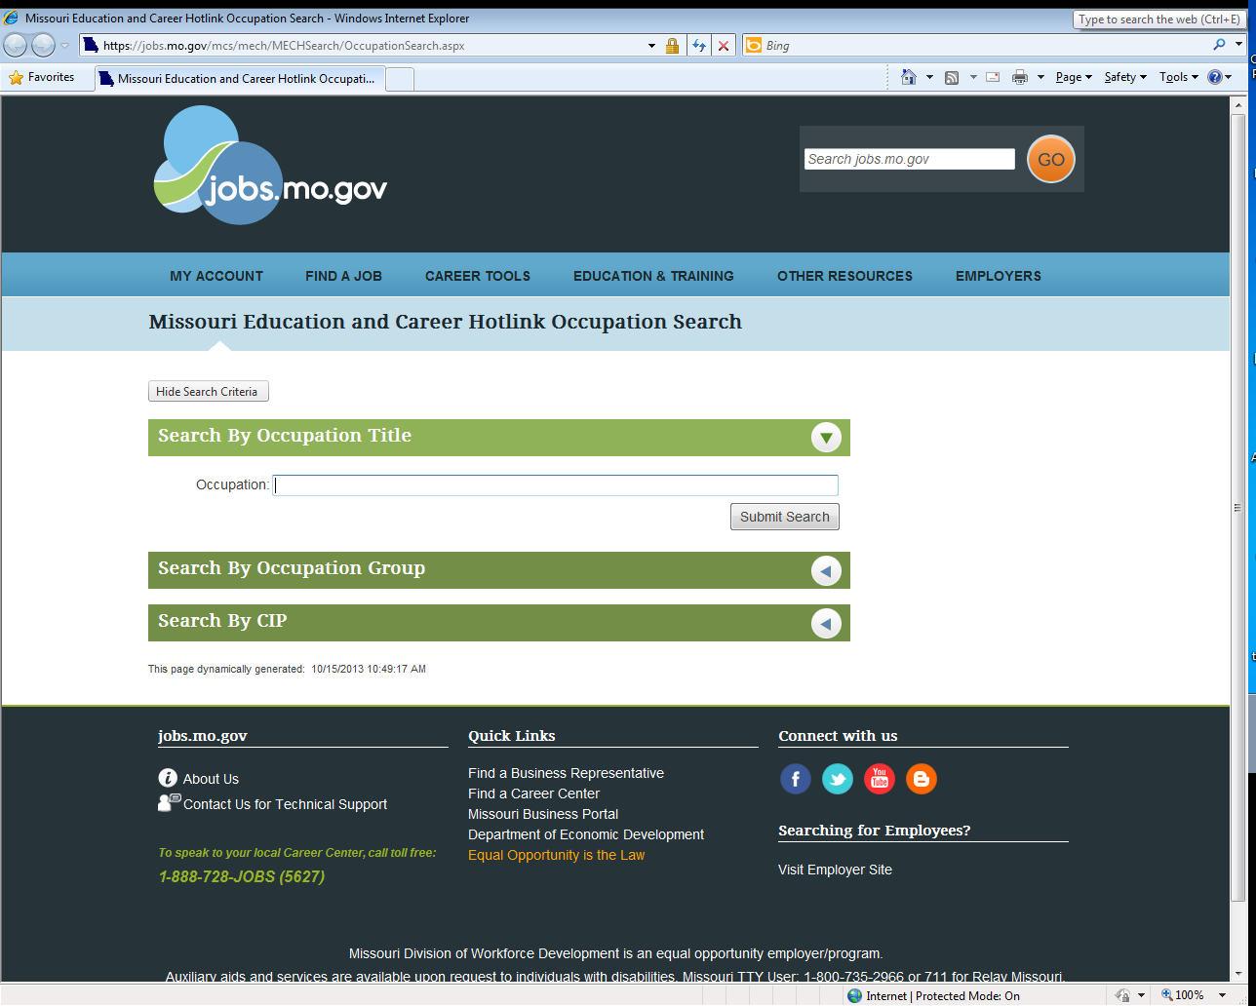
Search by Occupation Title or CIP code
https://jobs.mo.gov/mcs/mech/MECHSearch/OccupationSearch.aspx
Notes:
The simplest way to search for an occupation in the Missouri Education and Career Hotlink is to type (*) it into the search box.

Slide 27
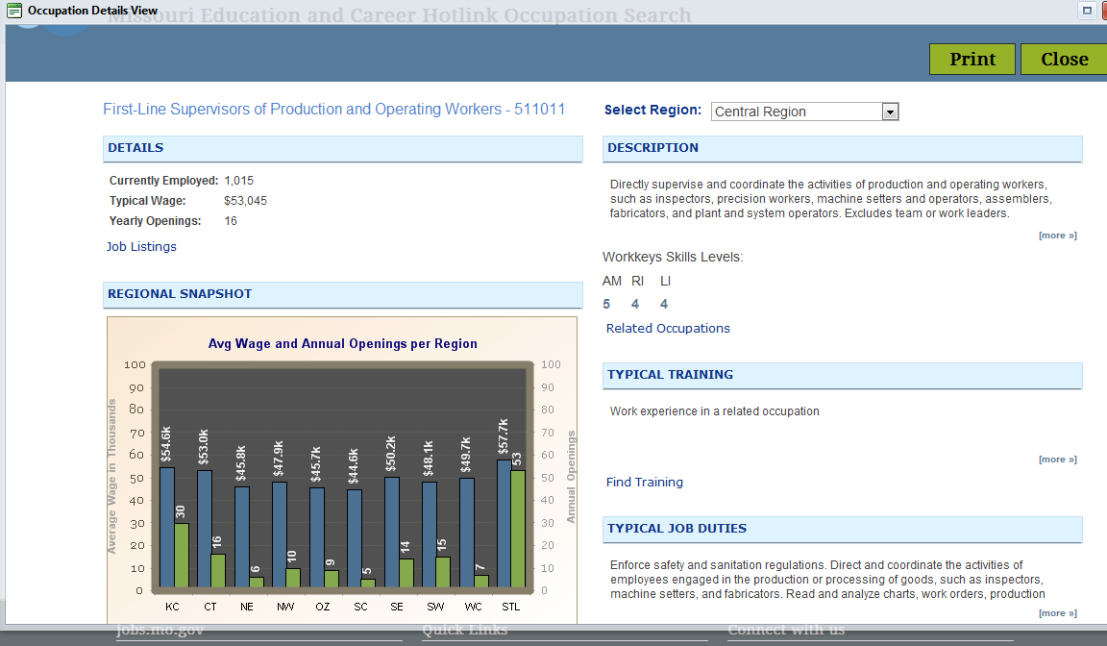
Occupation Details
Notes:
Once inside the first line supervisor of production and operating workers occupation site, you can select a particular region from the drop-down menu in the top right. Information available includes job description, wages, link to job listings, and WorkKeys scores.
To find a training program for the occupation in the region, you will click on the hyperlink for Find Training.
The training hyperlink is currently being updated and does not work for all occupations right now. It will in the future. However, you can also use the Institution Search to search for information on training programs.

Slide 28
Specify an Occupation
https://jobs.mo.gov/mcs/mech/MECHSearch/InstitutionSearch.aspx
Notes:
With the Institution Search, you can sort through programs by institution name, program name, the type of degree they wish to obtain, or the regional location of programs.
We are choosing to use the occupation search to look at Operations Management and Supervision.

Slide 29
Notes:
From the training specific site here, we can see the description of the training to be received and the list of institutions that provide the training.

Slide 30
Notes:
If you click on any of the hyperlinks you will see more information about the program and contact information for the institution, as well as information on program cost and program performance.

Slide 31
Step 4 Website Links
O*Net Online:
http://online.onetcenter.org/
Missouri Education and Career Hotlink: https://jobs.mo.gov/mcs/mech/MECHSearch/OccupationSearch.aspx
Missouri Institution Search: https://jobs.mo.gov/mcs/mech/MECHSearch/InstitutionSearch.aspx
Notes:
Here are the website links to the LMI Data tools that we walked through in Step 4 of the Four Step Aid to Assisting Job Seekers. Please feel free to pause the webinar here and practice using these data tools yourself. Otherwise make note of them and continue on to finish the lesson.

Slide 32
O*Net Online Resources
For more O*Net Online resources and available products and assessment tools
www.onetcenter.org
For more training on using O*Net effectively
www.onetacademy.com
Includes power points, lesson plans, webinars/recordings, and podcasts relating to all things O*Net
Notes:
For more access to the tools and products offered by O*Net Online, you can go to their resource center above. Another O*Net resource is the O*Net Academy. It offers power point lessons, webinars, and podcasts on how to use O*Net effectively for different audiences.

Slide 33
Your Turn to Practice
Now that you have seen an example of how you can help a job seeker gain re-employment, it is time to practice helping more people using the tools that you learned in Robert’s case study.
Notes:
So now is the time for you to practice using the LMI tools that we have covered. You will be read a scenario regarding a job seeker or business that has come to your career center needing assistance. There will be a set of questions following each scenario. Answer the questions using the tools that you have learned in Robert’s case study.
You may also use the Four Step Aid to Assisting Job Seekers Handout from the module to look at what websites you will need to access to help the individuals in the following scenarios. Please have this webinar open in one screen and your web browser open in another so you can navigate and answer the questions at the same time.

Slide 34
Scenario 1
Julie – freight driver for a trucking transportation firm in St. Louis, MO who is losing her job.
20 years experience in transportation
Willing to take additional training in a new field
Needs to return to work soon
Needs better job security
Notes:
Julie has worked as a freight truck driver for 20 years. The company that she works for has recently shut down, and she has lost her job.
Julie is 40 years old and the highest education level that she has completed is high school. She will not be able to take a job outside the St. Louis area. However, she would be willing to receive additional training in a different field, but she is unsure of how well her skills would translate to a new job. Job security and returning to work soon are very important to her in evaluating what her next career move will be.
An Employee Transition Team has been called in to assist the recently laid off employees of her trucking company. You have been assigned as her career counselor. How can you help Julie with her re-employment?

Slide 35
Questions
What is the percentage change in employment for the short term within the truck transportation industry (48-4000) in the St. Louis WIA?
What is the numerical change in employment for the short-term for a truck driver, heavy & tractor trailer (53-3032) in the St. Louis WIA?
What are some of the skills required of a truck driver, heavy & tractor trailer (53-3032)?
Where can Julie obtain training to meet the occupational requirements of a new high-demand occupation?
Notes:
To help Julie begin her search for re-employment, let’s answer these questions using the LMI tools outlined in Lessons 1 and 2 of this module.
What is the percentage change in employment for the short-term within the truck transportation industry (48-4000) in the St. Louis WIA?
What is the numerical change in employment for the short-term for a truck driver, heavy & tractor trailer (53-3032) in the St. Louis WIA?
What are some of the common skills required of truck driver, heavy & tractor trailer (53-3032)?
Where can Julie obtain training to meet the occupational requirements of a new high-demand occupation?

Slide 36
Scenario 2
Tom and Mary—need new personnel for their growing business
Software and training consulting company
Want to add a sales manager position in their company
Need help developing a position announcement that describes the skill set that they are seeking in an employee
Notes:
Tom and Mary Phelps own a small consulting company currently catering to providing software and training to small business clients. They have been very successful with their current client base and have great referrals for new business. Both Tom and Mary have experience with software development, but have no real experience in sales and marketing strategies. They want to expand their products as well as increase their customer base.
In order to meet these goals, Tom and Mary want to add a sales manager position in their company to handle sales and marketing to existing customers and developing new customers. They need help in determining what skills are necessary for the new position and how to develop a position announcement that describes those skills.
They have come into the career center to ask you for help in developing a job description for a sales manager.

Slide 37
Questions
What SOC code best matches the description of the sales manager position Tom and Mary wish to fill?
What are the skills needed for the position that should be listed in the job opening description?
What are some colleges that provide training (11-2022) for this occupation where they can advertise their opening?
Using the long-term employment projections, what should Tom and Mary expect to pay their new employee if their business is located in the Northeast WIA?
Notes:
To help Tom and Mary begin their search for a new employee, let’s answer these questions using the LMI tools outlined in Lessons 1 and 2 of this module.
What SOC code best matches the description of the sales manager position Tom and Mary wish to fill?
What are the skills needed for the position that should be listed in the job opening description?
What are some colleges that provide training (11-2022) for this occupation where they can advertise their opening?
Using the long-term employment projections, what should Tom and Mary expect to pay their new employee if their business is located in the Northeast WIA?

Slide 38
Thank you for your participation!
Contact us at:
mericdata@ded.mo.gov
Fax: (573) 751-7160
www.missourieconomy.org
Notes:
Thank you for participating in this LMI series of webinars. If you have any questions regarding this training or would like additional LMI data information, please feel free to contact us by e-mail at mericdata@ded.mo.gov. You may also visit MERIC’s website at www.missourieconomy.org for additional resources and contact information for your assigned regional staff liaison.

Slide 39
Please take a moment to complete this survey, which is available online at the link below. Your input will assist us in making these webinars more effective and successful as we continue to make further improvements.
http://www.surveymonkey.com/s/M7BLRV9

