Slide 1



Module 4: Lesson 2
Practicum
Local Employment Dynamics
U.S. Department of Labor—Employment & Training Administration| Missouri Economic Research and Information Center| Missouri Department of Economic Development
This project has been funded, either wholly or in part, with Federal funds from the Department of Labor, Employment & Training Administration under Task Order Number DOLJ061A20373; the mention of trade names, commercial products, or organizations does not imply endorsement of same by the U.S. Government.
Notes:
Welcome to the Module 4 Practicum lesson.
Module 4: Guiding Businesses to Use Labor Market Information Resources to Support their human resources needs
is an advanced level course designed to discuss common labor and market challenges faced by employers and how DWD professionals can use LMI to serve employer needs

Slide 2
Today’s Lesson
✓
Module 1: Labor Market Information Fundamentals
Module 2: Skills Assessments & Career Pathway Planning
Module 3: Using Economic & Workforce Data to Drive Re-employment Strategy
Module 4: Guiding Businesses to Use LMI Resources to Support Human Resource Functions
  Lesson 1: LMI and Business Relations
  Lesson 2: Practicum
✓
✓
✓
Notes:
Before participating in this lesson, you must complete:
Module 1, Lesson 1 “LMI Fundamentals,” and
Module 4 Lesson 1.
It is recommend that you be familiar with the content of Module 3 LMI for Strategic Planning and Re-employment Lessons 1 and 2.
(Advance Slide)

Slide 3

What’s in it for me?
After participating in this exercise, you will be able to:
  Extract data from Local Employment Dynamics data sources
  Compare data extractions
  Identify efficient uses for each type of data source
Notes:
Today’s lesson will put the skills of Lesson 1 into practice while supplementing them with additional Missouri specific resource options. These resources are intended to help you anticipate client needs and formulate solutions.
After participating in this exercise, you will be able to:
Demonstrate data extraction from national and Missouri specific LMI sources,
Compare data extractions,
And Identify efficient uses for each type of data source
Before continuing, please make sure you have the module 4: Lesson 2 “Webinar Study Aide” printed and ready for use.

Slide 4
Where are the answers - LED
Local Employment Dynamics
Tools for Synthesized Detailed Information
OnTheMap
By combining data from different LMI sources (Census, BLS) local employment information, once unavailable, is now easily accessible.
Quarterly Workforce Indicators (QWI)
Industry Focus
http://lehd.did.census.gov
Notes:
In previous lessons you were introduced to the Local Employment Dynamics platform which contains three tools that synthesize detailed information:
First, Quarterly Workforce Indicators (QWI) provides labor market measures
Second, OnTheMap creates customized portraits of who works where, doing what and for what compensation
Lastly, Industry Focus describes local business and workforce characteristics.
LED fills a critical gap in workforce statistics by combining data from two sources collected for different reasons:
-- state wage and unemployment records submitted quarterly to the Bureau of Labor Statistics, and
-- current demographic information from the Census Bureau
The combined results present a more complete picture of the industry and workforce landscape of particular geographies.
(Advance Slide)

Slide 5
LED Industry Focus
Customized Searches
Industry Indicators
Quickly report the top industries for an area.
Based on Worker Demographics:
  Age Group
  Gender
  Education
  Race/Ethnicity
Organized by Geographies:
  State
  WIA
  Metro
  County
Specific to Industry Sectors
Employment
Growth in Employment
Growth in Hiring
Number of New Hires
Firm Job Change
Average Monthly Earning for All Workers
Growth in Average Monthly Earning for All Workers
Average Monthly Earning for New Hires
Notes:
Today we will explore the third LED portal, Industry Focus. After which, you will be asked to extract and compare similar data from each portal.
The LED Industry Focus data portal allows a user to build customized searches to rank top industries by prescribed criteria like
Worker demographics,
Different geographies, or
Industry sectors

Slide 6
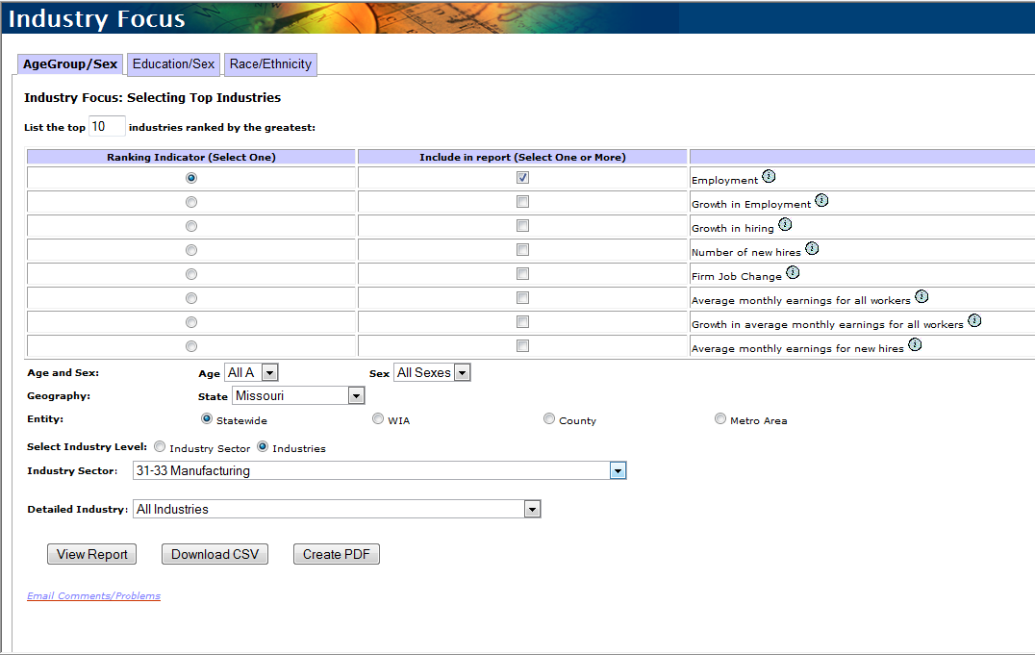
LED – Industry Focus
Notes:
Shown here is the Industry Focus data portal found under the “Data” tab of the LED main page. The bottom half of the screen provides the various filters you can apply to a search to answer questions like:
Which industries have a male dominated workforce?
Which industries hire the most young workers? or
Which Missouri industry reports the highest growth in new hires?
Industry Focus returns reports that rank industries based on the “Ranking Indicator” you select when building a search. However, it will return any combination of the indicators that you select from the “include in report” column.

Slide 7
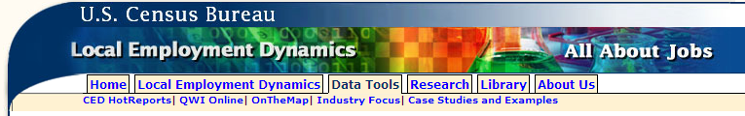
Practicum
U.S. Census Bureau:
Local Employment Dynamics
http://lehd.did.census.gov
Industry Focus
Quarterly Workforce Indicators
OnTheMap
Notes:
As you will remember from LMI Fundamentals, MERIC is the state labor market information collection agency. Most data collected for the Bureau of Labor Statistics is collected by a state agency, vetted and then handed to the national office. When possible, MERIC has provided a data portal on Missourieconomy.org for the state collected data. QWI is an example of state collected data, searchable on the MERIC website. However, because Industry Focus and OnTheMap rely on synthesized data from the BLS and the Census bureaus they must be accessed through the master LED website managed by the Census Bureau.
The rest of this lesson provides you the opportunity to apply what you have learned through this series. You will navigate through each LED data portal to answer three data extraction questions.
The Webinar Study Aide you were asked to print at the beginning of this lesson provides the questions on the left-hand side and the answers needed on the right-hand side of the sheet. The six slides captured on the sheet are the remaining slides of this webinar.
At this time Launch the website listed here, pause the webinar, reduce the webinar screen and focus entirely on the LED website.
Work your way through the three questions and collect the answers on your worksheet. When you have completed all three:
return to the webinar,
Advance to the end, and
Continue on to the assessment portion of this lesson.

Slide 8
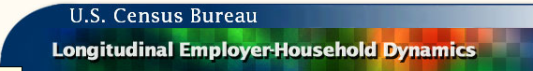
Practice - Data Extraction
Use Local Employment Dynamics to answer the questions below.
Industry Focus
  What is the average quarterly total employment for the highest ranked Manufacturing industry in Missouri?
    Answer with the 3-digit NAICS code, and
    Average Quarterly Employment total reported.
Quarterly Workforce Indicators
OnTheMap
Notes:
Use LED’s Industry Focus data portal to answer this question.

Slide 9
LED – Data Extraction
Industry Focus
Industry: _______________
QWI
OnTheMap
Total: _______________
Notes:
Note the answers you extracted from LED’s Industry Focus on your Webinar Study Aide.

Slide 10
Practice - Data Extraction
Use Local Employment Dynamics to answer the questions below.
Industry Focus
Quarterly Workforce Indicators
  Using the 3-digit NAICS manufacturing industry identified in the Industry Focus search, build the same search in QWI.
    Answer with the difference between the total employment reported by each portal.
OnTheMap
Notes:
Use QWI data portal to answer this question.

Slide 11
LED – Data Extraction
Industry Focus
QWI
Industry Focus Total Employment: ______
OnTheMap
QWI Total Employment: - ______
Difference in Totals: = ______
  Industry: _______________
  Total: _______________
Notes:
Note the answers you extracted from LED’s Quarterly Workforce Indicator on your Webinar Study Aide.

Slide 12
Practice - Data Extraction
Use Local Employment Dynamics to answer the questions below.
Industry Focus
Quarterly Workforce Indicators
OnTheMap
  Use OnTheMap to build an Area Profile Analysis of Bates County Missouri. What is the Total Primary Manufacturing jobs count for the most current data year available in OnTheMap?
    Answer with the count and year.
Notes:
Use LED’s OnTheMap data portal to answer this question.

Slide 13
LED – Data Extraction
Industry Focus
QWI
Industry Focus Total Employment: ______
OnTheMap
QWI Total Employment: - ______
Difference in Totals: = ______
Total Primary Manufacturing Jobs: ______
Year: ______
  Industry: _______________
  Total: _______________
Notes:
Note the answers you extracted from LED’s OnTheMap on your Webinar Study Aide.

Slide 14

Thank you for your participation!
Contact us at:
mericdata@ded.mo.gov
Fax: (573) 751-7160
www.missourieconomy.org
Notes:
Thank you for participating in this LMI series of webinars. If you have any questions regarding this training or would like additional LMI data information, please feel free to contact us by e-mail at mericdata@ded.mo.gov. You may also visit MERIC’s website at www.missourieconomy.org for additional resources and contact information for your assigned regional staff liaison.

Slide 15
Please take a moment to complete this survey, which is available online at the link below. Your input will assist us in making these webinars more effective and successful as we continue to make further improvements.
http://www.surveymonkey.com/s/M7BLRV9

